Slide 1
Performance, Releases, and Reliability
Engineering Software as a Service
© 2012 David Patterson & David Patterson
Licensed under Creative Commons Attribution-NonCommercial-ShareAlike 3.0 Unported License

Slide 2
Outline of topics
Availability and responsiveness
Apdex
Monitoring
Upgrades & feature flags
Relieving database pressure: indices and abusive queries
Relieving database pressure: caching
Defending customer data

Slide 3
From Development to Deployment
Engineering Software as a Service §12.1

Slide 4
Development vs. Deployment
Development: Testing to make sure your app works as designed
Deployment: Testing to make sure your app works when used in ways it was not designed to be used

Slide 5
Bad News
“Users are a terrible thing”
Some bugs only appear under stress
Production environment != development environment
The world is full of evil forces
and idiots

Slide 6
Good News: PaaS makes deployment way easier
get Virtual Private Server (VPS), maybe in cloud
install and configure Linux, Rails, Apache, mysqld, openssl, sshd, ipchains, squid, qmail, logrotate…
fix almost-weekly security vulnerabilities
find yourself in Library Hell
tune all moving parts to get most bang for buck
figure out how to automate horizontal scaling

Slide 7
Our goal: stick with PaaS!
PaaS handles… | We handle…
“Easy” tiers of horizontal scaling | Minimize load on database
Component-level performance tuning | Application-level performance tuning (e.g. caching)
Infrastructure-level security | Application-level security
Is this really feasible?
Pivotal Tracker and Basecamp each run on a single DB (128GB commodity box <$10K)
Many SaaS apps are not world-facing (internal or otherwise limited interest)

Slide 8
Performance and security Defined
Performance Stability
Availability or Uptime
What percentage of time is site up and accessible?
Responsiveness
How long after a click does user get response?
Scalability
As number users increases, can you maintain responsiveness without increasing cost/user?
Privacy
Is data access limited to the appropriate users?
Authentication
Can we trust that user is who s/he claims to be?
Data integrity
Is users' sensitive data tamper-evident?
Security

Slide 9
Non-Functional Requirements
Specifies how the system should behave
A constraint on system behavior

Slide 10
Which of the following is a non-functional requirement?
Ratings are on the scale of 1 to 5
Response time must be < 200 ms
Traffic to and from the site must be encrypted
B and C
All of the above

Slide 11
Quantifying Availability and Responsiveness
Engineering Software as a Service §12.2, 12.5

Slide 12

Is response time important?
How important is response time?*
Amazon: +100ms => 1% drop in sales
Yahoo!: +400ms => 5-9% drop in traffic
Google: +500ms => 20% fewer searches
Classic studies (Miller 1968, Bhatti 2000)
<100 ms is “instantaneous”
>7 sec is abandonment time
Jeff Dean, Google Fellow
“Speed is a feature”

Slide 13

Where does the time go? (server/network)
Request sent
OS/network stack
Web server
App (controller & model)
Database access
View rendering
OS/network stack
Response
Time
1st byte delivered
rendering starts (“time to glass”)
last byte delivered
request embedded IMGs
all assets loaded;
run scripts
rendering done

Slide 14
Where does the time go? (client)
CSS selectors + JavaScript interpreter = 41% of total client rendering time
Especially selectors that require walking DOM tree such as div > li
Browsers compete on speed of JavaScript interpreter
selector/parser performance are increasingly the bottleneck!
HTML parser
parser
21%
DOM
CSS rules
selector engine
29%
selector engine
layout engine
9%
rendering
rendering
23%
JavaScript interpreter
JavaScript interpreter
12%
Courtesy Leo Meyerovich, UC Berkeley

Slide 15
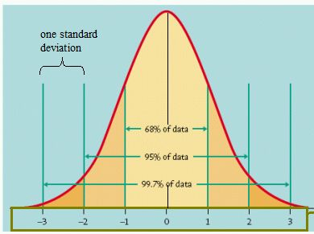
Simplified (and false) view of response time
For standard normal distribution of response times around mean: ±2 standard deviations around mean is 95% confidence interval
Average response time T means:
95 percentile users are getting T+2s
99.7 percentile users get T+3s

Slide 16
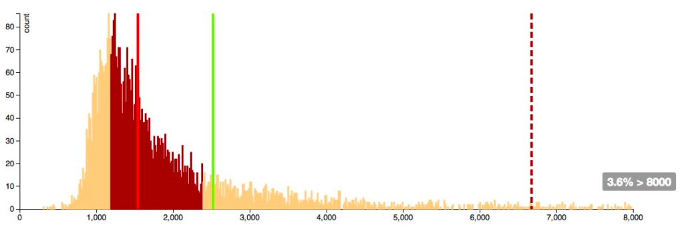
A real example
95%
25%
75%
Mean
Courtesy Bill Kayser, Distinguished Engineer, New Relic. http://blog.newrelic.com/breaking-down-apdex
Used with permission of the author.
50%
(median)

Slide 17
Scalability
An overloaded and abused term—means different things in different fields
For SaaS: as number of users increases, response time to user stays same
Response time is key user-facing SaaS metric
Ideally also want: as number of users increases, cost to serve each user stays same (or decreases)
A possible metric: users per server per $
captures effects of throughput (or “bandwidth”)

Slide 18
Service Level Objective (SLO)
Time to satisfy user request
latency or response time
SLO: Instead of worst case or average: what % of users get acceptable performance
Specify percentile, target response time, time window
e.g., 99% < 1 sec, over a 5 minute window
why is time window important?
Service level agreement (SLA) is an SLO to which provider is contractually obligated
Notes:
Which does provider care about?
Which does customer care about?

Slide 19
Apdex: simplified SLO
Given a threshold latency T for user satisfaction:
Satisfactory requests take t≤T
Tolerable requests take T≤ t ≤ 4T
Apdex = (#satisfactory + 0.5(#tolerable)) / #reqs
0.85 to 0.93 generally “good”
Warning! Can hide systematic outliers if not used carefully!
e.g. critical action occurs once in every 15 clicks but takes 10x as long => (14+0)/15 > 0.9

Slide 20
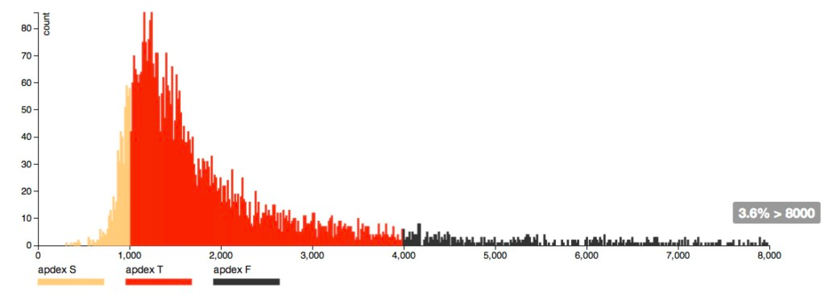
Apdex Visualization
T=1000ms, Apdex = 0.49

Slide 21
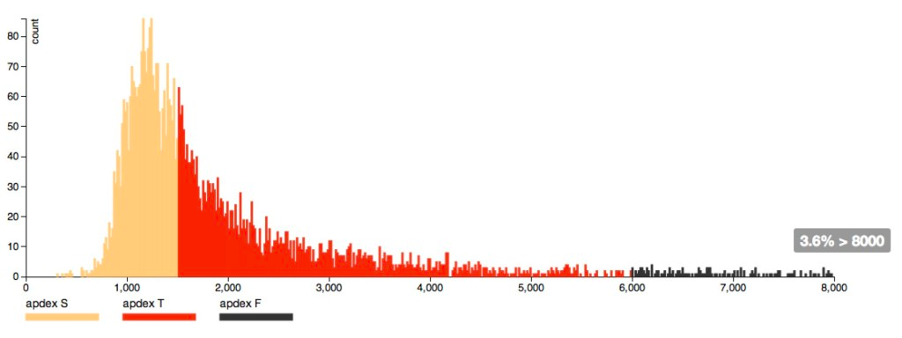
Apdex Visualization
T=1500ms, Apdex = 0.7

Slide 22
What to do if site is slow?
Small site: overprovision
applies to presentation and logic tier
before cloud computing, this was painful
today, it's largely automatic (e.g. Rightscale)
Large site: worry
Provision 10,000-computer site by 10% results in 1000 idle computers
Insight: same problems that push us out of PaaS-friendly tier are the ones that will dog us when larger!

Slide 23
Which of the following statements regarding response time are true?
Response time is impacted only by the network and server-side activities
Database queries have minimal impact response time
CSS and JavaScript have an impact on response time on the client side
All of the above

Slide 24
According to research, at what threshold do users become dissatisfied with responsiveness?
>100 ms
>1 second
>2 seconds
>7 seconds

Slide 25
Continuous Integration and Continuous Deployment
Engineering Software as a Service §12.3

Slide 26
Releases Then and Now
Facebook: master branch pushed once a week, aiming for once a day (Bobby Johnson, Dir. of Eng., in late 2011)
Amazon: several deploys per week
StackOverflow: multiple deploys per day (Jeff Atwood, co-founder)
GitHub: tens of deploys per day (Zach Holman)
Rationale: risk == # of engineer-hours invested in product since last deploy!
Like development and feature check-in, deployment should be a non-event that happens all the time

Slide 27

Successful Deployment
Automation: consistent deploy process
PaaS sites like Heroku, CloudFoundry already do this
Use tools like Capistrano for self-hosted sites
Continuous integration: integration-testing the app beyond what each developer does
Pre-release code checkin triggers CI
Since frequent checkins, CI always running
Common strategy: integrate with GitHub

Slide 28
Why CI?
Differences between dev and production environments
Cross-browser or cross-version testing
Testing SOA integration when remote services act wonky
Hardening: protection against attacks
Stress testing/longevity testing of new features/code paths
Example: Salesforce CI runs 150K+ tests and automatically opens bug report when test fails

Slide 29
Continuous Deployment
Push => CI => deploy several times per day
deploy may be auto-integrated with CI runs
So are releases meaningless?
Still useful as customer-visible milestones
Tag specific commits with release names
git tag 'happy-hippo' HEAD git push --tags
Or just use Git commit ID to identify release

Slide 30
Upgrades and Feature Flags
Engineering Software as a Service §12.4

Slide 31
The trouble with upgrades
What if upgraded code is rolled out to many servers?
During rollout, some will have version n and others version n+1…will that work?
What if upgraded code goes with schema migration?
Schema version n+1 breaks current code
New code won't work with current schema

Slide 32
Naïve update
Take service offline
Apply destructive migration, including data copying
Deploy new code
Bring service back online
May result in unacceptable downtime

Slide 33
Incremental Upgrades with Feature Flags
Do nondestructive migration
Deploy method protected by feature flag
Flip feature flag on; if disaster, flip it back
Once all records moved, deploy new code without feature flag
Apply migration to remove old columns

Slide 34
“Undoing” an upgrade
Disaster strikes…use down-migration?
is it thoroughly tested?
is migration reversible?
are you sure someone else didn't apply an irreversible migration?
Use feature flags instead
down-migrations are primarily for development

Slide 35
Other uses for feature flags
Preflight checking: gradual rollout of feature to increasing numbers of users
to scope for performance problems
A/B testing
Complex feature whose code spans multiple deploys
The rollout gem covers these cases and more

Slide 36
Identify the false statement related to continuous integration (CI)
CI is not possible with a compiled language, such as Java.
CI consists of running a set of integration tests prior to deployment.
CI relieves heavily on automation.
Deployment to production when all CI tests pass may result in several deployments each day.

Slide 37
App changes that involve changes to the database
require the service to be take offline, so that the migration can be performed
can be done while the app is running by having a code path work with the old schema and a separate code path that runs with the new schema
use feature flags to modify database fields
should be rolled back when there are problems with the release

Slide 38
Monitoring
Engineering Software as a Service §12.6

Slide 39
Kinds of monitoring
“If you're not monitoring it, it's probably broken”
At development time (profiling)
Identify possible performance/stability problems before they get to production
In production
Internal: instrumentation embedded in app and/or framework (Rails, Rack, etc.)
External: active probing by other site(s).

Slide 40
Why use external monitoring?
Detect if site is down
Detect if site is slow for reasons outside measurement boundary of internal monitoring
Get user's view from many different places on the Internet
Example: Pingdom

Slide 41
Sampling of monitoring tools
What is monitored | Level | Example tool | Hosted
Availability | site | pingdom.com | Yes
Unhandled exceptions | site | airbrake.com | Yes
Slow controller actions or DB queries | app | newrelic.com (also has dev mode) | Yes
Clicks, think times | app | Google Analytics | Yes
Process health & telemetry (MySQL server, Apache, etc.) | process | god, monit, nagios | No

Slide 42
What to measure?
Stress testing or load testing: how far can I push my system
before performance becomes unacceptable?
before it gasps and dies?
Usually, one component will be bottleneck
a particular view, action, query, …
Load testers can be simple or sophisticated
bang on a single URI over and over
do a fixed sequence of URI's over and over
play back a log file

Slide 43
Longevity Bugs
Resource leak (RAM, file buffers, sessions table) is classic example
Some infrastructure software such as Apache already does rejuvenation
aka “rolling reboot”
Related: running out of sessions
Solution: store whole session[] in cookie (Rails 3 does this by default)

Slide 44
Caching: Improving Rendering Time and Database Performance
Engineering Software as a Service §12.6

Slide 45
The fastest database is the one you don't use
Caching: Avoid touching database if answer to a query hasn't changed
Identify what to cache
whole view: page and action caching
parts of view: fragment caching with partials
Invalidate (get rid of) stale cached versions when underlying DB changes

Slide 46
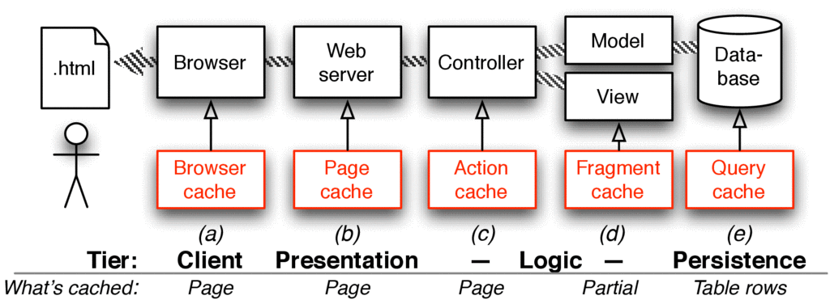
Cache flow

Slide 47
Page and Action Caching
When: output of entire action can be cached
Page caching bypasses controller action caches_page :index
Action caching runs filters first
Caveat: caching based on page URL without optional "?" parameters!
/movies/index?rating=PG = movies/index
/movies/index/rating/PG ≠ movies/index
Pitfall: don't mix filter and non-filter code paths in same action!

Slide 48
Example
Better:
caches_page :public_index
caches_action :logged_in_index
before_filter :check_logged_in, :only => 'logged_in_index'
def public_index
...
end
def logged_in_index
...
end
Bad:
caches_page :index
def index
if logged_in?
...
else
redirect_to login_path
end
end

Slide 49
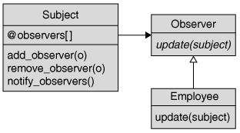
Fragment caching for views
Caches HTML resulting from rendering part of a page (e.g. partial)
- cache "movies_with_ratings" do
= render :collection => @movies
How do we detect when cached versions no longer match database?
Sweepers use Observer design pattern to separate expiration logic from rest of app

Slide 50
Avoiding Abusive Queries
Engineering Software as a Service §12.8

Slide 51
Be kind to the database
Outgrowing single-machine database == big investment: sharding, replication, etc.
Alternative: find ways to relieve pressure on database so can stay in “PaaS-friendly” tier
Use caching to reduce number of database accesses
Avoid “n+1 queries” problem in Associations
Use indices judiciously

Slide 52
n+1 queries problem
Problem: you are doing n+1 queries to traverse an association, rather than 1 query
Solution: bullet gem can help you find these
Lesson: all abstractions eventually leak!

Slide 53
Eager loading
Naive way:
@movie = movie.where( … ) reviews = @movie.reviews
May be faster:
@movie = movie.where( … ).include(:reviews) @movie.reviews.each do |review| # reviews are already loaded!

Slide 54
Indices
Speeds up access when searching DB table by column other than primary key
e.g. Movie.where("rating = 'PG'")
Similar to using a hash table
alternative is table scan—bad!
even bigger win if attribute is unique-valued
Why not index every column?
takes up space
all indices must be updated when table updated

Slide 55
What to index?
Foreign key columns, eg movie_id field in Reviews table
why?
Columns that appear in where() clauses of ActiveRecord queries
Columns on which you sort
Use rails_indexes gem (on GitHub) to help identify missing indices (and unnecessary ones!)

Slide 56
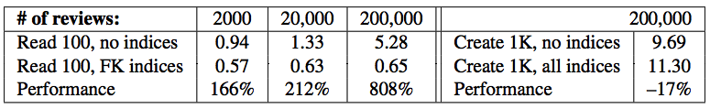
How much does indexing help?
Time in seconds to read 100 reviews
Performance penalty from indices on create:

Slide 57
How can caching improve performance?
By avoiding a database query
By avoiding re-rendering a view
By storing the result of a complex computation
All of the above

Slide 58
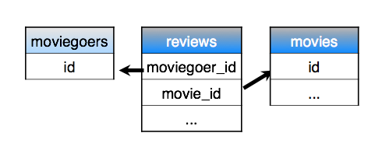
Suppose Movie has many Moviegoers through Reviews
Which foreign-key index would MOST help speed up the query
fans = @movie.moviegoers
reviews.moviegoer_id
moviegoers.review_id
reviews.movie_id
movies.review_id

